Slide 1
Activation function
purpose of an activation function is to add non-linearity to the neural network.
An Activation Function decides whether a neuron should be activated or not.
This means that it will decide whether the neuron’s input to the network is important or not in the process of prediction using simpler mathematical operations.
The role of the Activation Function is to derive output from a set of input values fed to a node (or a layer)
The primary role of the Activation Function is to transform the summed weighted input from the node into an output value to be fed to the next hidden layer or as output.

Slide 2
1)Linear Activation Function:
The linear activation function, also known as "no activation," or "identity function" (multiplied x1.0), is where the activation is proportional to the input.
The function doesn't do anything to the weighted sum of the input, it simply spits out the value it was given.
formula :
f(x)=x
Drawbacks:
It’s not possible to use backpropagation as the derivative of the function is a constant and has no relation to the input x.
All layers of the neural network will collapse into one if a linear activation function is used.
No matter the number of layers in the neural network, the last layer will still be a linear function of the first layer.
So, essentially, a linear activation function turns the neural network into just one layer.

Slide 3
2)Binary Step Function:
Binary step function depends on a threshold value that decides whether a neuron should be activated or not.
The input fed to the activation function is compared to a certain threshold; if the input is greater than it, then the neuron is activated,
else it is deactivated, meaning that its output is not passed on to the next hidden layer.
formula :
f(x)= 0 for x<0
1 for x>=0
drawbacks:
It cannot provide multi-value outputs—for example, it cannot be used for multi-class classification problems.
The gradient of the step function is zero, which causes a hindrance in the backpropagation process.

Slide 4
3)Non-Linear Activation Functions:
They allow backpropagation because now the derivative function would be related to the input, and it’s possible to go back and understand which weights in the input neurons can provide a better prediction.
They allow the stacking of multiple layers of neurons as the output would now be a non-linear combination of input passed through multiple layers.
Any output can be represented as a functional computation in a neural network.
i)Sigmoid / Logistic Activation Function :
It is commonly used for models where we have to predict the probability as an output.
Since probability of anything exists only between the range of 0 and 1, sigmoid is the right choice because of its range.
The function is differentiable and provides a smooth gradient, i.e., preventing jumps in output values.
This is represented by an S-shape of the sigmoid activation function.
This function takes any real value as input and outputs values in the range of 0 to 1.
The larger the input (more positive), the closer the output value will be to 1.0, whereas the smaller the input (more negative), the closer the output will be to 0.0

Slide 5
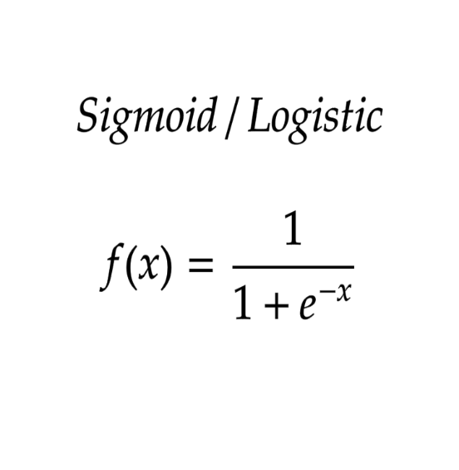
Formula of sigmoid :
Drawbacks :
The output of the logistic function is not symmetric around zero. So the output of all the neurons will be of the same sign.
This makes the training of the neural network more difficult and unstable.

Slide 6
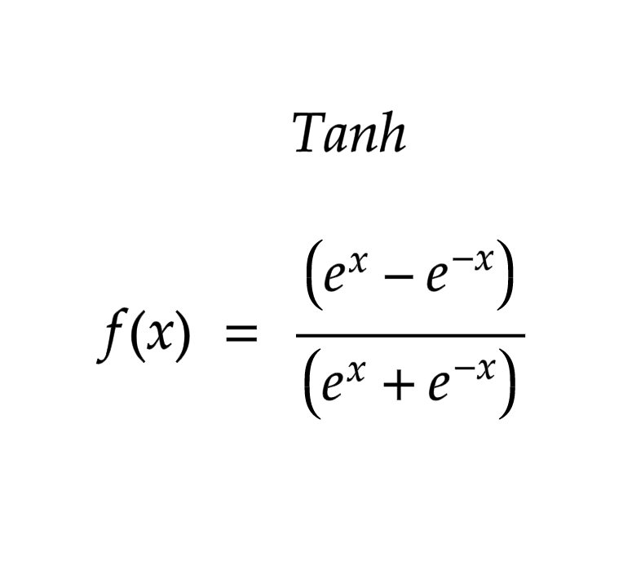
ii)Tanh Function (Hyperbolic Tangent):
Tanh function is very similar to the sigmoid/logistic activation function, and even has the same S-shape with the difference in output range of -1 to 1.
In Tanh, the larger the input (more positive), the closer the output value will be to 1.0, whereas the smaller the input (more negative),the closer the output will be to -1.0.
The output of the tanh activation function is Zero centered; hence we can easily map the output values as strongly negative, neutral, or strongly positive.
Usually used in hidden layers of a neural network as its values lie between -1 to 1 therefore, the mean for the hidden layer comes out to be 0 or very close to it.
It helps in centering the data and makes learning for the next layer much easier.
Drawback:
It causes the Vanishing Gradient. It is non-zero centered. It is saturated
Formula :

Slide 7
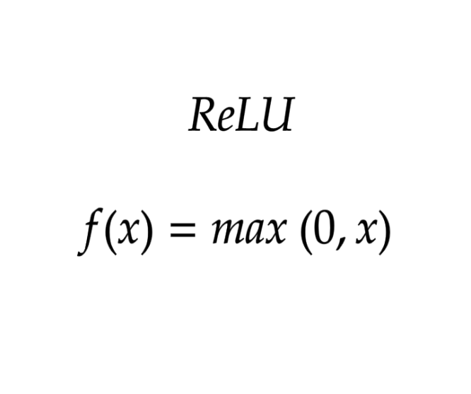
iii) ReLU Function:
ReLU stands for Rectified Linear Unit.
Although it gives an impression of a linear function, ReLU has a derivative function and allows for backpropagation while simultaneously making it computationally efficient.
The main catch here is that the ReLU function does not activate all the neurons at the same time.
The neurons will only be deactivated if the output of the linear transformation is less than 0.
Formula :

Slide 8
The advantages of ReLU :
Since only a certain number of neurons are activated, the ReLU function is far more computationally efficient when compared to the sigmoid and tanh functions.
ReLU accelerates the convergence of gradient descent towards the global minimum of the loss function due to its linear, non-saturating property.
Drawbacks :
The negative side of the graph makes the gradient value zero. Due to this reason, during the backpropagation process, the weights and biases for some neurons are not updated. This can create dead neurons which never get activated.
All the negative input values become zero immediately, which decreases the model’s ability to fit or train from the data properly.

Slide 9
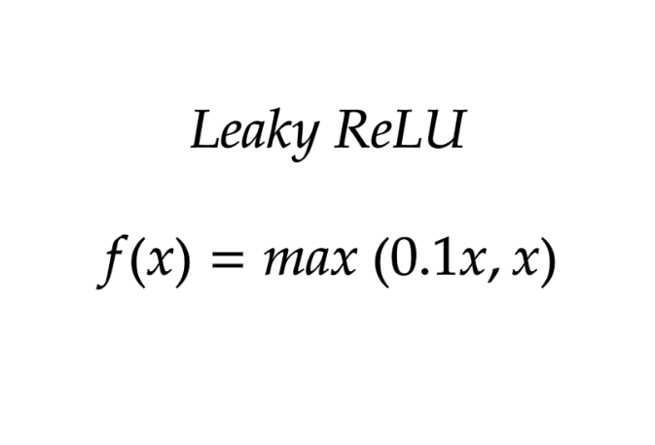
iv)Leaky ReLU
Leaky ReLU is an improved version of ReLU function to solve the Dying ReLU problem as it has a small positive slope in the negative area.
Formula :
advantages :
Leaky ReLU are same as that of ReLU, in addition to the fact that it does enable backpropagation, even for negative input values.
By making this minor modification for negative input values, the gradient of the left side of the graph comes out to be a non-zero value. Therefore, we would no longer encounter dead neurons in that region.
limitations :
The predictions may not be consistent for negative input values.
The gradient for negative values is a small value that makes the learning of model parameters time-consuming.

Slide 10
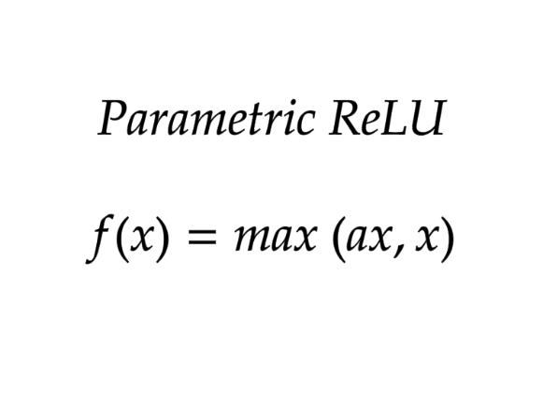
v) Parametric ReLU Function:
Parametric ReLU is another variant of ReLU that aims to solve the problem of gradient’s becoming zero for the left half of the axis.
This function provides the slope of the negative part of the function as an argument a. By performing backpropagation, the most appropriate value of a is learnt.
Formula :
Where "a" is the slope parameter for negative values.
Advantage:
The parameterized ReLU function is used when the leaky ReLU function still fails at solving the problem of dead neurons, and the relevant information is not successfully passed to the next layer.
Drawback :
This function’s limitation is that it may perform differently for different problems depending upon the value of slope parameter a.

Slide 11
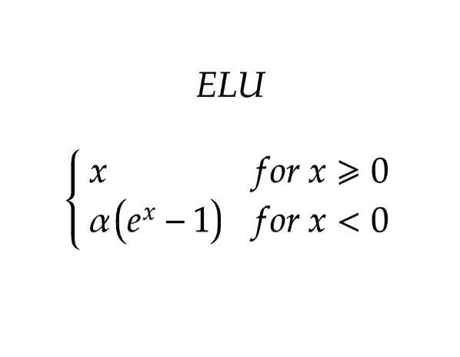
vi) Exponential Linear Units (ELUs) Function
Exponential Linear Unit, or ELU for short, is also a variant of ReLU that modifies the slope of the negative part of the function.
ELU uses a log curve to define the negative values unlike the leaky ReLU and Parametric ReLU functions with a straight line.
Formula
Advantages
ELU becomes smooth slowly until its output equal to -α whereas RELU sharply smoothes.
Avoids dead ReLU problem by introducing log curve for negative values of input. It helps the network nudge weights and biases in the right direction.
Drawbacks:
It increases the computational time because of the exponential operation included
No learning of the ‘a’ value takes place
Exploding gradient problem

Slide 12
vii) Softmax :
Before exploring the ins and outs of the Softmax activation function, we should focus on its building block—the sigmoid/logistic activation function that works on calculating probability values.
The output of the sigmoid function was in the range of 0 to 1, which can be thought of as probability.
Let’s suppose we have five output values of 0.8, 0.9, 0.7, 0.8, and 0.6, respectively. How can we move forward with it?
The answer is: We can’t.
The above values don’t make sense as the sum of all the classes/output probabilities should be equal to 1.
You see, the Softmax function is described as a combination of multiple sigmoids.
It calculates the relative probabilities. Similar to the sigmoid/logistic activation function, the SoftMax function returns the probability of each class.
It is most commonly used as an activation function for the last layer of the neural network in the case of multi-class classification.

Slide 13
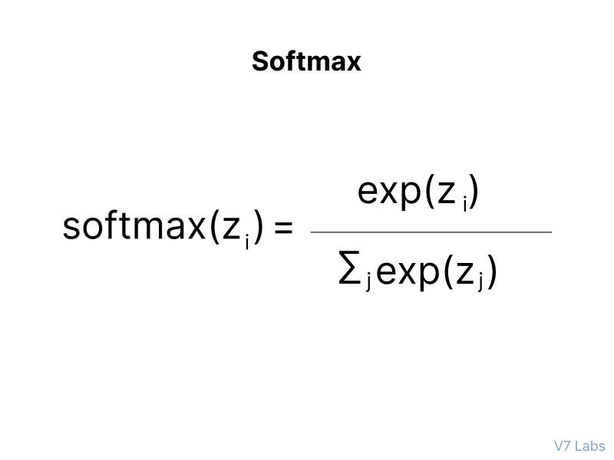
Advantages:
Separating multiple classes efficiently
No restriction on batch selection compared to contrastive or triplet loss
Easy implementation
Drawbacks:
If there are too many classes, it will be problematic for memory fit (a common issue)
It fits well to high quality images (see upper figure below) due to its maximization conditional probability. However, it ignores the rare difficult images (see bottom figure below) from the training mini-batch.
Formula:

Slide 14
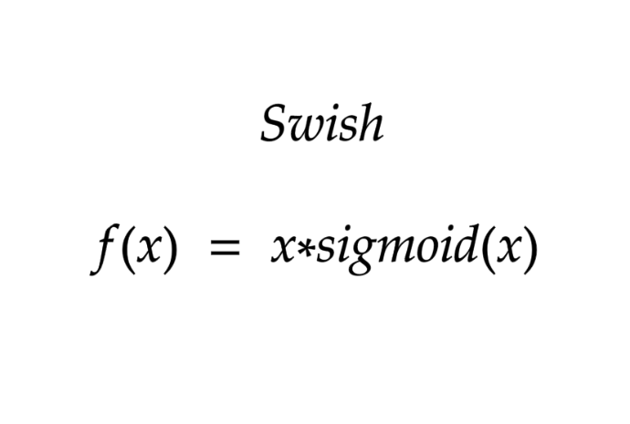
viii) Swish :
It is a self-gated activation function developed by researchers at Google.
Swish consistently matches or outperforms ReLU activation function on deep networks applied to various challenging domains such as image classification, machine translation etc.
Formula
advantages
Swish is a smooth function that means that it does not suddenly change direction like ReLU does near x = 0. Rather, it smoothly bends from 0 towards values < 0 and then upwards again.
Small negative values were zeroed out in ReLU activation function. However, those negative values may still be relevant for capturing patterns underlying the data. Large negative values are zeroed out for reasons of sparsity making it a win-win situation.
The swish function being non-monotonous enhances the expression of input data and weight to be learnt.

Slide 15
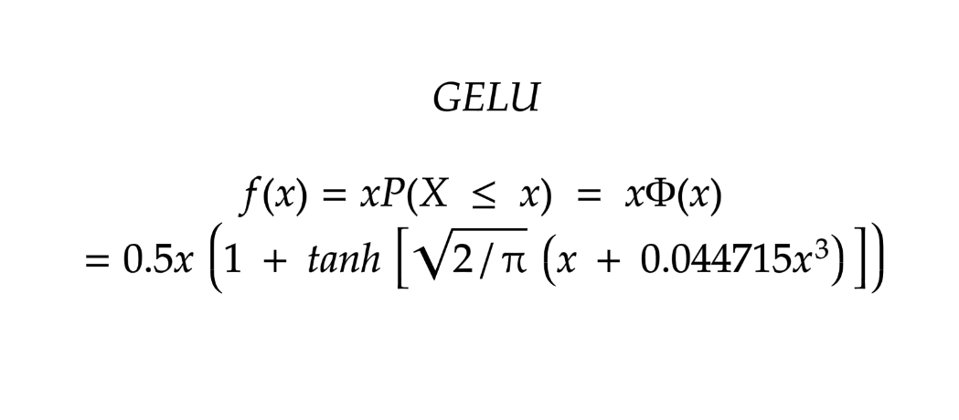
ix) Gaussian Error Linear Unit (GELU)
The Gaussian Error Linear Unit (GELU) activation function is compatible with BERT, ROBERTa, ALBERT, and other top NLP models. This activation function is motivated by combining properties from dropout, zoneout, and ReLUs.
Formula
Advantage
GELU nonlinearity is better than ReLU and ELU activations and finds performance improvements across all tasks in domains of computer vision, natural language processing, and speech recognition.

Slide 16
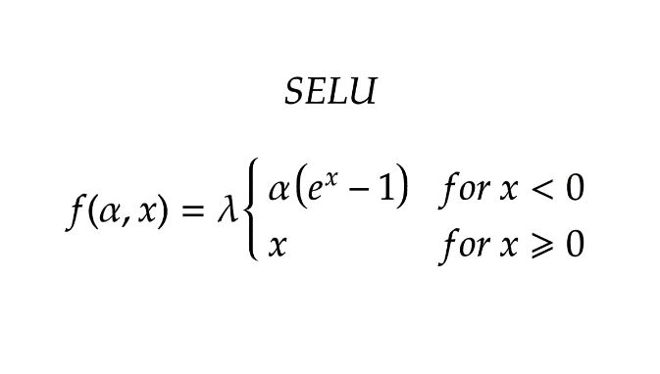
x) Scaled Exponential Linear Unit (SELU)
SELU was defined in self-normalizing networks and takes care of internal normalization which means each layer preserves the mean and variance from the previous layers. SELU enables this normalization by adjusting the mean and variance.
SELU has both positive and negative values to shift the mean, which was impossible for ReLU activation function as it cannot output negative values.
Gradients can be used to adjust the variance. The activation function needs a region with a gradient larger than one to increase it.
Formula
SELU has values of alpha α and lambda λ predefined.
advantage of SELU over ReLU:
Internal normalization is faster than external normalization, which means the network converges faster.
SELU is a relatively newer activation function and needs more papers on architectures such as CNNs and RNNs, where it is comparatively explored.

Slide 17
How to choose the right Activation Function?
ReLU activation function should only be used in the hidden layers.
Sigmoid/Logistic and Tanh functions should not be used in hidden layers as they make the model more susceptible to problems during training (due to vanishing gradients).
Swish function is used in neural networks having a depth greater than 40 layers.

Slide 18
Few rules for choosing the activation function for your output layer based on the type of prediction problem that you are solving:
Regression - Linear Activation Function
Binary Classification—Sigmoid/Logistic Activation Function
Multiclass Classification—Softmax
Multilabel Classification—Sigmoid
Convolutional Neural Network (CNN) ,(ANN): ReLU activation function.
Recurrent Neural Network: Tanh and/or Sigmoid activation function.

